Slide 1
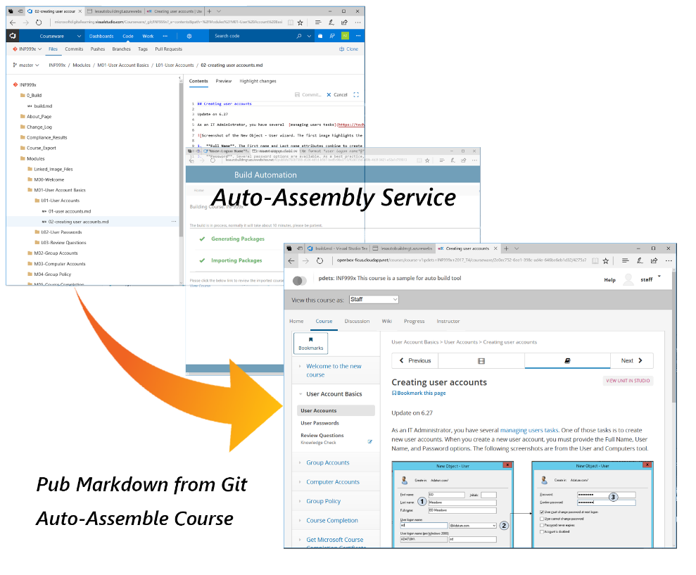
Auto-Assembly Tool
Assemble a course within just 10 minutes by yourselves.
Have WYSIWYG feature.
Support both Classic and Advanced Mode
Support color coding for all programming languages
Make easy version control in Git for all content changes;
Notes:
Manual assembly takes 4 business days;
Authors can preview the course by individual pages or by an entire course on the staging server;
Support both Classic ( all settings are standard, no actions for Authors) and Advanced ( sophisticated course and content settings via metadata files ) Markdown sources;
Support color coding for all programming languages to enhance student experience;
Make easy version control in Git for all content changes;

Slide 2
Resources
Auto-Assembly User Guide
Sample course: INF 999x
Content Development Detail Process with Auto-Assembly Tool
Content Development Task Checklist (Infographics version) (Word Version)
Staging environment account:
Email: AutoAssembly@outlook.com; Password: Pa$$w0rd
PDETS Office Hours:
Every Wednesday afternoon 3:00pm to 4:00pm till the end of Sept.

